Slide 1
PREDICT Boston Airbnb Price
ALY6140 Analytics Systems Technology term B
INSTRUTOR: Jialun He
Member: Bo Li, Minyi Chen
3/26/2019

Slide 2
Introduction
Project goal: Use regression models to predict Boston Airbnb price
Project structure: Data, Data cleanup, Data exploration, Modeling, Conclusion

Slide 3
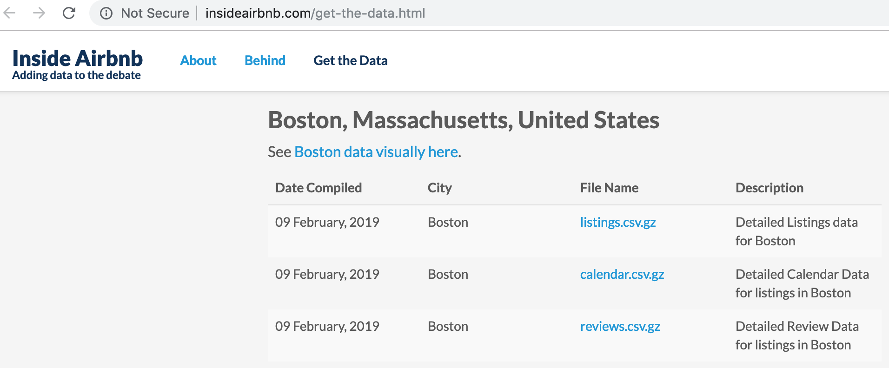
Data

Slide 4
Dataset with Selected features
Columns: total 18 columns, 17 input features, 1 output label price.
Rows: records from 6155 Airbnb listings in Boston
Output Label
Categorical Features (5)
Numerical Features (12)
host_is_superhost
accommodates
neighbourhood_cleansed
property_type
room_type
cancellation_policy
bathrooms
bedrooms
beds
minimum_nights
maximum_nights
availability_365
availability_90
availability_60
availability_30
number_of_reviews
price

Slide 5
Data cleanup: output label
Output label Price: delete dollar sign and change the data type to numerical number
Mean 206.8
Min 0
50% 150
75% 220
Max 5000
No missing values

Slide 6
Data cleanup: input features
There are missing values in bedrooms, bathrooms, beds, and host_is_superhost
Bedrooms 6
Bathrooms 5
Beds 3
Host_is_superhost 2
Replace the missing values with 0

Slide 7
Data visualization
Histogram
Correlation heatmap

Slide 8
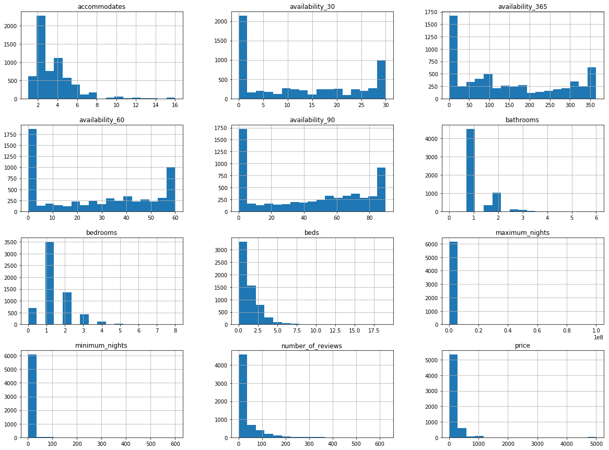
Histogram
Distribution for pricing is strongly skewed right
Most listings: 2-4 people, one bed, and one bedrooms.

Slide 9
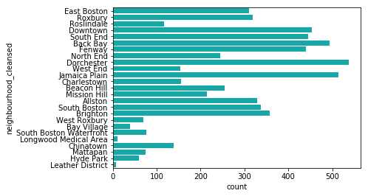
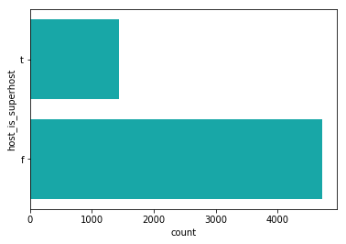
More than 400 listings: Dorchester, Jamaica Plain, Back Bay, Downtown, South End, and Fenway
About 23% of the listings are host by superhost.

Slide 10
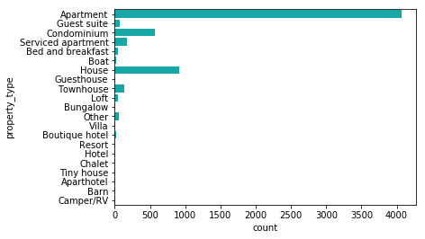
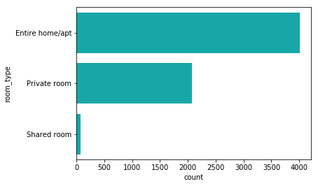
Most popular property_type are apartments, house, and Condo.
About 4000 listings are the entire home and 2000 listings are private room.

Slide 11
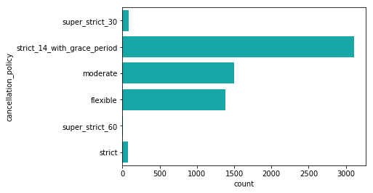
About 3000 listings has the strict_14_with_grace_period cancellation policy.
Cancellation policies:
https://www.airbnb.com/home/cancellation_policies?guest_fee_policy=grace_period_48_hours#moderate

Slide 12
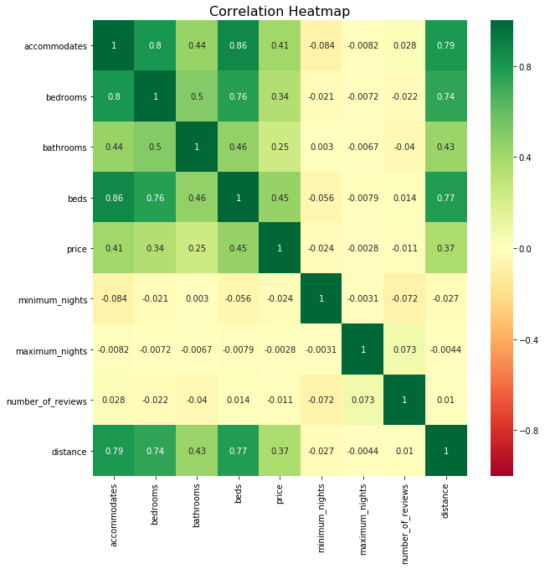
Correlation
The correlation between beds and accommodates is very high 0.86
Price doesn’t have strong correlations with input features.

Slide 13
Machine learning models
Separate dataset into train and test
Build regression models
Evaluate model
Improve model

Slide 14
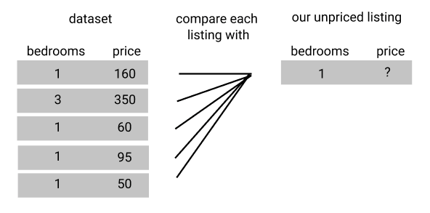
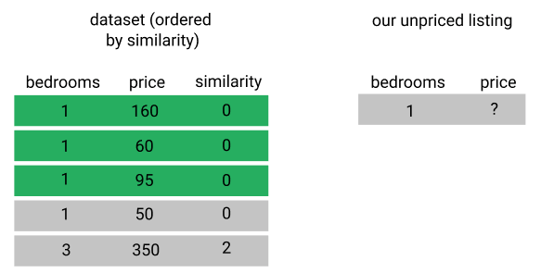
We are now ready to model with listing data. To predict what factors house prices are related to. Here we are going to use KNN to calculate.

Slide 15


Slide 16
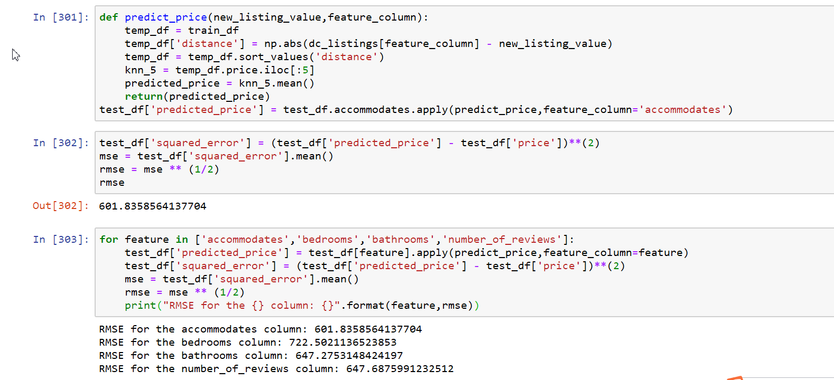

Slide 17
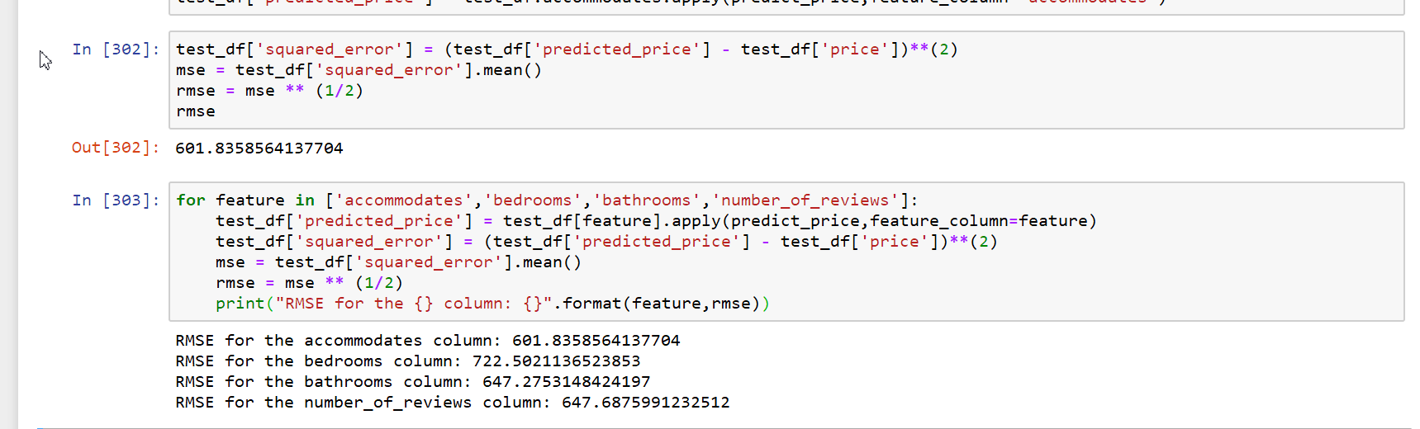

Slide 18
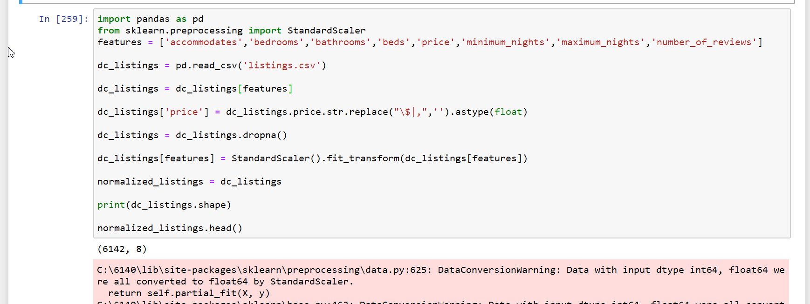

Slide 19
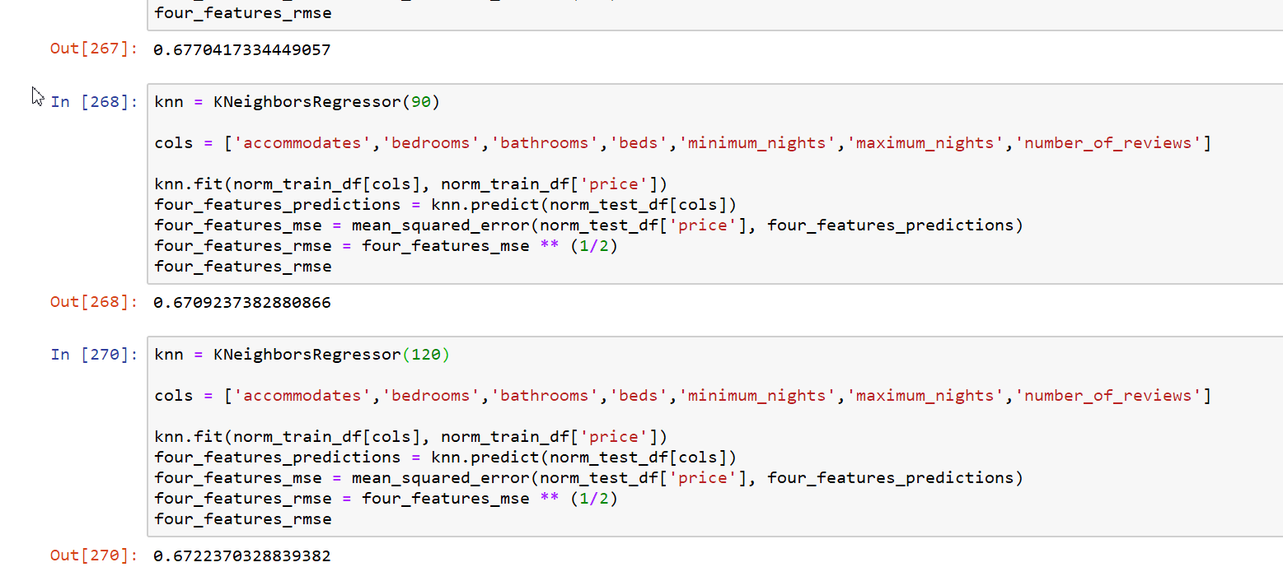

Slide 20
Conclusion
Finally, we take N = 50, 90, 120 to see which parameter works best. When N = 90, RMSE value is the smallest and the effect is the best.

Slide 21
Reference
References:
Boston Airbnb open data. Https://www.Kaggle.Com/airbnb/boston/kernels
Airbnb pricing predictions. Https://airbnb-pricing-prediction.Herokuapp.Com

Slide 22
Thank you!

